Slide 1
Human Activity Recognition Using Smartphones

Slide 2
INTRODUCTION
Human activity recognition is the problem of classifying sequences of accelerometer data recorded by specialized harnesses or smart phones into known well-defined movements.
In this project, we calculate a model by which a smartphone can detect its owner’s activity precisely.for the dataset 30 people were used to perform 6 different activities.
Using the smartphone’s embedded sensors(the accelerometer and the gyroscope), the user’s speed and the acceleration were measured in 3-axial directional.We use the sensor’s data to predict the user’s activity.
Goal: We will try to predict human activities like Walking, Walking Upstairs, Walking Downstairs, Sitting, Standing and Laying

Slide 3
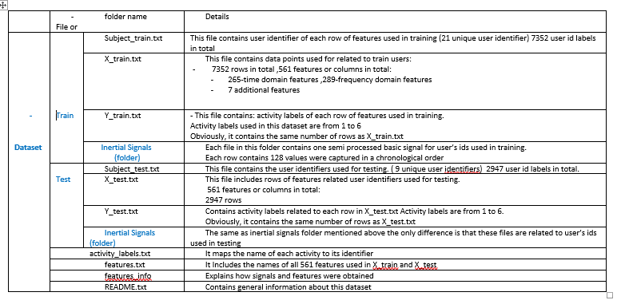
Inspecting the Dataset and the compressed folders

Slide 4
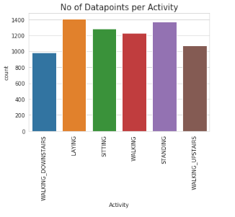
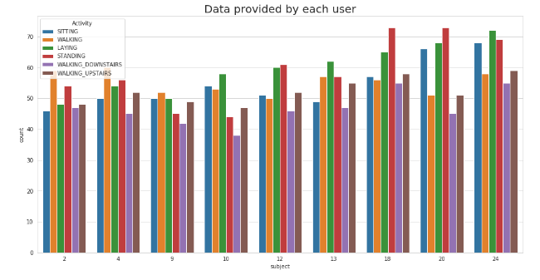
Data Visualization
Data Cleaning:
INITIAL EXPLORATION AND VISUALIZATION: In-order to make sure the dataset under consideration doesn’t have any major data quality issues like class imbalance, missing data etc. that will hinder the performance of classification models to a huge extent we start with the basic analysis of our dataset using visualizations.
We start our analysis of data by checking if the data has class imbalance issue. The plot of the target variable ‘Activity’. We observed that there isn’t much variation in the class label counts
Data provided by each user
We have got almost same number of reading from all the subjects .
Distribution of classes is balanced per train and test set and also per subject.

Slide 5
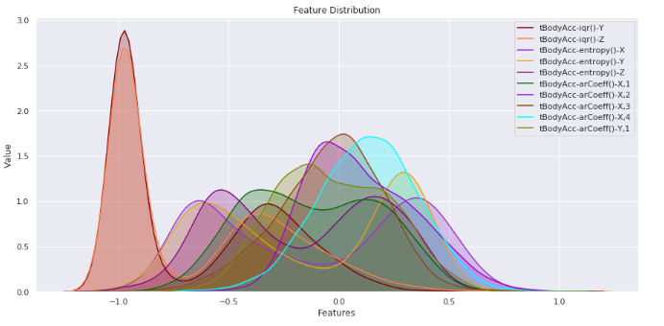
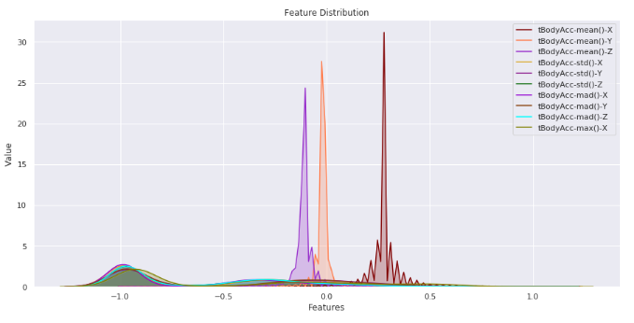
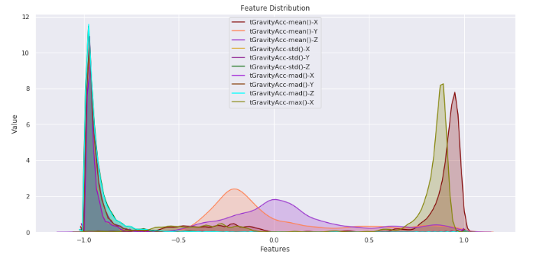
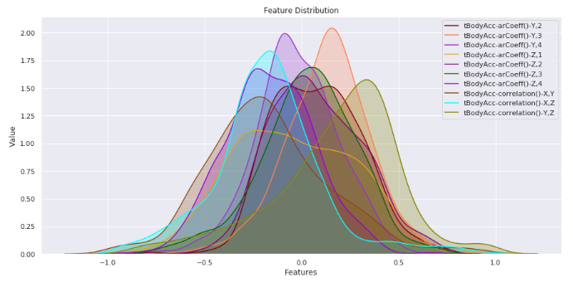
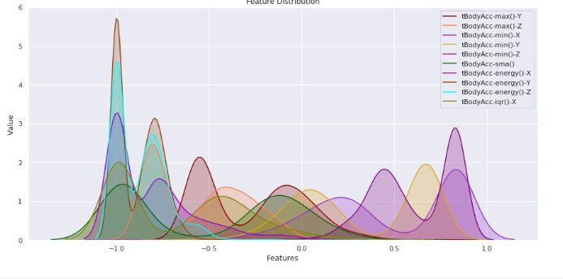
Feature visualization

Slide 6
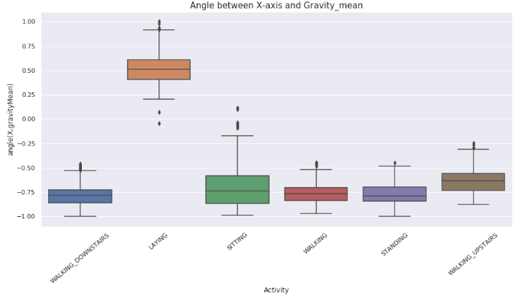
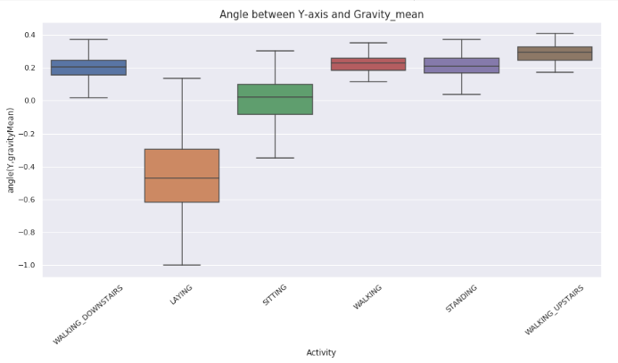
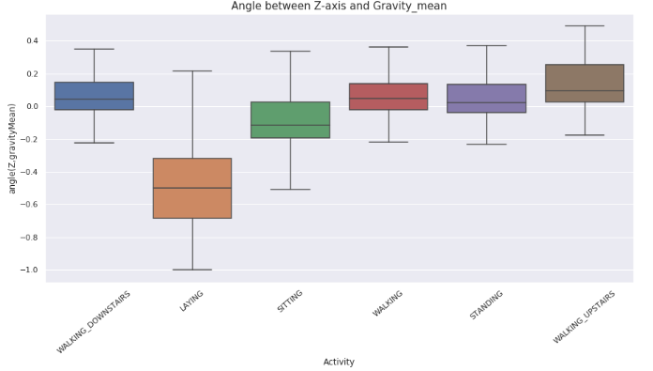
Relationship between Position of Gravity Acceleration Components and the Target (activity)
From the above visualization we can see that the Gravity Acceleration Component in X direction is more variable than in Y and Z direction. If we observe closely, for the active activities: WALKING, WALKING_UPSTAIRS and WALKING_DOWNSTAIRS the variation in X-axis more compared the passive activities: STANDING, SITTING and LAYING.

Slide 7
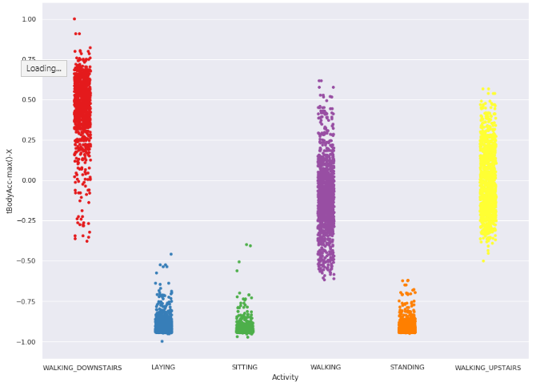
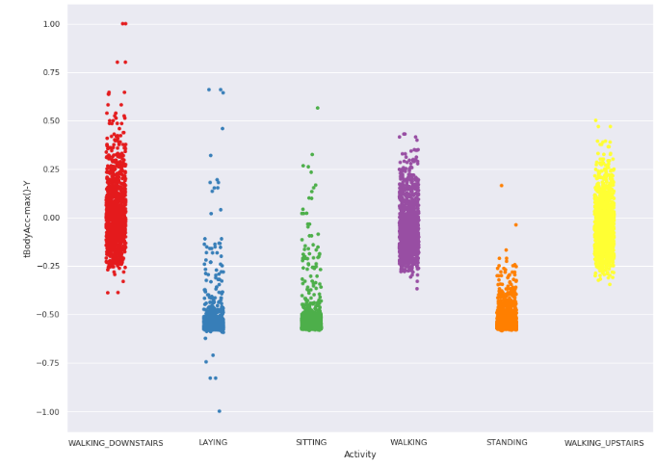
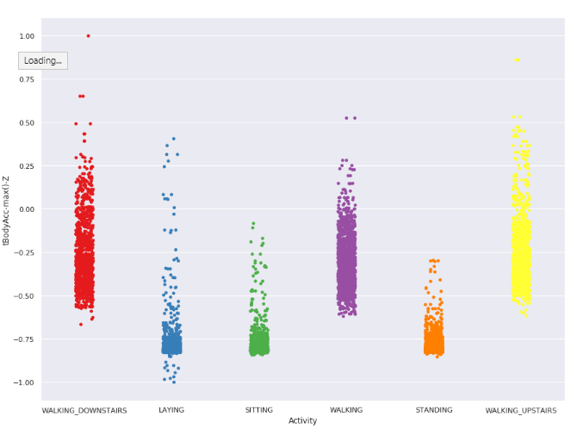
Relationship between Max body acceleration and the Target (activity)
Comparing the above Strip-plot, we can clearly see that for Max Acc in all directions, the Passive activities are way below the active ones and for the active one the variation is also huge. If we notice in the first of the two plots, WALKING_DOWNSTAIRS has a greater value of Max body acceleration. This can be explained as when a person walks down the stairs, his body moves comparatively faster compared to when he is steadily walking or Walking_upstairs

Slide 8
Data Preparation :
The data already appears to have been scaled to the range [-1,1].
LabelEncoder : Converts categorical data, or text data, into numbers, which the predictive models can better understand. We encode both the train and test target variable.
Data Normalization
Feature Selection :We can see that the ‘subject’ column which is the subject who has taken reading for this dataset has no real effect on the output activity as all the subjects has performed the same activities and predicting an activity is not dependent on the subject in any way, we can discard that feature
Predictive Modeling : The problem is a time series multi-class classification problem.It may also be framed as a binary classification problem and a multi-step time series classification problem.
Models to explore include :
Machine learning algorithms.
Multilayer Perceptron.
Recurrent neural networks, specifically LSTMs.
Metrics : Once the model has been trained on the training data, its performance will be evaluated using the test data. The following metrics will be used:
Accuracy – will be used for evaluating the performance of the model on the test data.
Confusion Matrix - will be used in order to compare the model with the Benchmark model. A confusion matrix is used to describe the performance of a classification model.

Slide 9
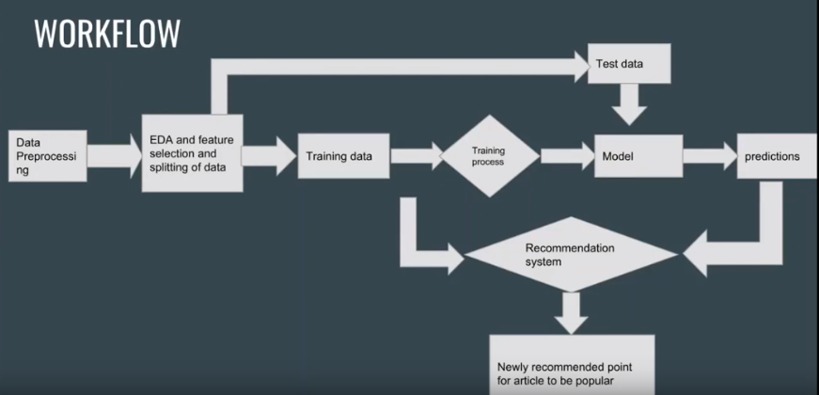

Slide 10
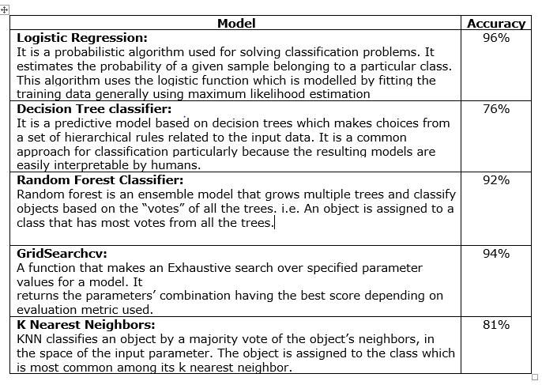
Machine Learning Algorithms

Slide 11
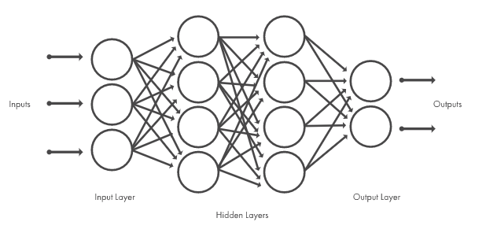
Deep Learning Models
Deep learning models use neural network architectures, which is why deep learning models are often referred to as deep neural networks.
The term “deep” usually refers to the number of hidden layers in the neural network. Traditional neural networks only contain 2-3 hidden layers, while deep networks can have as many as 150.
Deep learning models are trained by using large sets of labeled data and neural network architectures that learn features directly from the data without the need for manual feature extraction.
Supervised Models
Classic Neural Networks (Multilayer Perceptrons)
Convolutional Neural Networks (CNNs)
Recurrent Neural Networks (RNNs) & LSTM
Unsupervised Models
Self-Organizing Maps (SOMs)
Boltzmann Machines
AutoEncoders

Slide 12
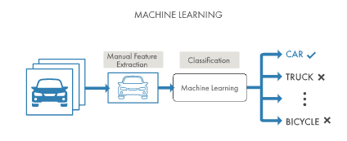
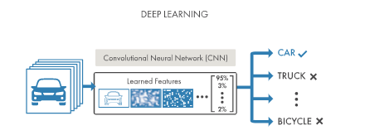
What's the Difference Between Machine Learning and Deep Learning?
Deep learning is a specialized form of machine learning. A machine learning workflow starts with relevant features being manually extracted from images. The features are then used to create a model that categorizes the objects in the image. With a deep learning workflow, relevant features are automatically extracted from images. In addition, deep learning performs “end-to-end learning” – where a network is given raw data and a task to perform, such as classification, and it learns how to do this automatically.
Another key difference is deep learning algorithms scale with data, whereas shallow learning converges. Shallow learning refers to machine learning methods that plateau at a certain level of performance when you add more examples and training data to the network.
A key advantage of deep learning networks is that they often continue to improve as the size of your data increases.

Slide 13
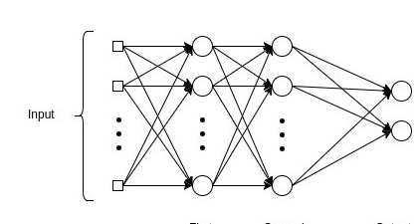
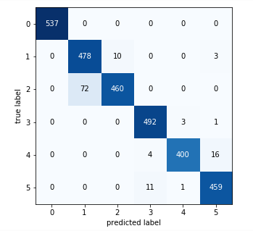
Multilayer Perceptrons
A Multilayer perceptron is the classic neural network model consisting of more than 2 layers.
A simple MLP classifier using Stochastic gradient descent optimizer gave an accuracy of 95%.
A MLP model with 3 hidden layers and 64v nodes and an output layer gave an accuracy of 96%

Slide 14
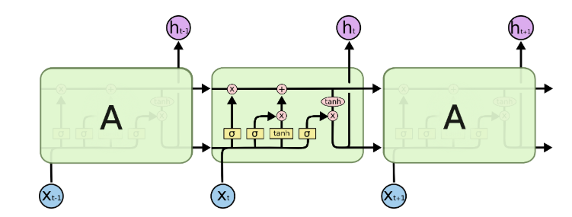
Long Short-Term Memory Networks(LSTM)
Long Short-Term Memory (LSTM) networks are a type of recurrent neural network capable of learning order dependence in sequence prediction problems.
The success of LSTMs is in their claim to be one of the first implements to overcome the technical problems and deliver on the promise of recurrent neural networks.
The two technical problems overcome by LSTMs are vanishing gradients and exploding gradients, both related to how the network is trained.
In this application, a LSTM model with a LSTM layer and two dense layer of 100 nodes and 0.5 dropout , gave an accuracy of 96%

Slide 15
Conclusion:
I got the best accuracy by implementing the Artificial Neural network, with an accuracy of 96%.
Best Machine learning algorithm with an accuracy of 94% was GridsearchCV
I think because of signal nature which is more categorical than linear and because of normalization on accelerometer and gyroscope signals have smooth and normalized signals ,hence ANN worked best.
Future Aspects:
The model developed can be used to predict Human Activity on real time basis. An application on Android Platform can be used to convey measurements and run the model on those measurements. This application has aspects in monitoring health and performance of athletes etc.

